Slide 1
Everything from Scratch A journey as Software Engineer in Test (SET) to improve "Testing"
Hiroyuki Ito
(@hageyahhoo)
Notes:
皆さん、お忙しいところお時間をいただき、ありがとうございます。
それでは私伊藤から、主にテスト自動化を推進・改善するためのヒントとして、「Everything from scratch」、すべてをイチから立ち上げた、LINEのSETの活動とそのポイントについてお話させていただきます。
ちなみにこの資料、本来であれば２週間後に開催される予定だった、世界最大のアジャイルのグローバルカンファレンス「Agile2020」の登壇資料として作成したものです。
そのカンファレンスの雰囲気を味わっていただきたい＋今回英語圏の参加者もいらっしゃることから、資料は英語、発表は日英同時通訳でお送りいたします。

Slide 2
Question
Have you faced with following troubles
for your test-related activities?
Some members/teams opposed your activities
No one used tools/solutions
you invented/introduced
There were few members who have enough skills/knowledge
Notes:
それでは最初に、皆さんに質問です。
主にテストに関する活動で、このような課題・トラブルを経験をされたこと、ありますでしょうか？

Slide 3
Troubles as SET
Hiro’s
Case
No clear goals by senior managers
Dissension among developers/testers/managers
Negative feedback
to our tools/solutions
Notes:
特に、私がLINEのSET第一号として入社した際に遭遇したものがこちらです。

Slide 4

We can change difficulties into something special with proper approaches!
Notes:
改善などの新しいことをする場合、多かれ少なかれ、このような問題にぶち当たるものです。
一方でこれらは、「適切な」アプローチ・方法で克服することが可能です。

Slide 5

Our team invented new ideas/tools/solutions from Scratch!
Notes:
今回は、我々SETが文字通りイチから築き上げたアイデア・ツール・ソリューションを紹介させていただきます。
ただし、紹介して終わりではありません。

Slide 6
Goal of This Session
Given we have troubles of testing
When we discuss and share troubles
And I share our solutions
Then we get hints to get over them
Notes:
私のこのセッションのゴールを、Cucumberなどで使われているGherkinの書式でまとめてみました。
Discussion→当初はイベント会場での議論を想定していましたが、今回はリモート…なので、ZoomとTwitterを活用しましょう。
ちなみに、なぜGherkinの書式にしたかと言いますと…
みなさんご存知かも知れませんが、Gherkinって「実行可能」なんです。なので、ぜひこのセッションで、みなさんの課題に適した解決策を考え、実行するところまで持っていきましょう。

Slide 7
Agenda
1. Importance of Getting Supports
2. Experience Hardships Together
3. Nurture All for Innovations
Notes:
5:00

Slide 8
1. Importance of Getting Supports
2. Experience Hardships Together
3. Nurture All for Innovations

Slide 9
Let’s Discuss! (5 min)
What blocks/blocked
Test Automation
in your organization?
Notes:
7:00 - 12:00
もともとイベント会場でみんなでワイワイする前提で、このディスカッションタイムを設定しています。
Zoomのチャット、またはTwitterを使いましょう。
皆さんの会社・組織・チームで、テスト自動化を「阻む」ものには、何がありますか？
あとでBlogに一つ一つ回答させてください。

Slide 10
Blockers
Hiro’s
Case
By decision-makers/colleagues
No clear vision/goals
No shared understanding
No supports
Unclear needs/demands

Slide 11
Blockers
Hiro’s
Case
By decision-makers/colleagues
No clear vision/goals
No shared understanding
No supports
Unclear needs/demands
They are critical!
Need to solve!

Slide 12

Key Point
How to get support/understanding
from
decision-makers
colleagues

Slide 13
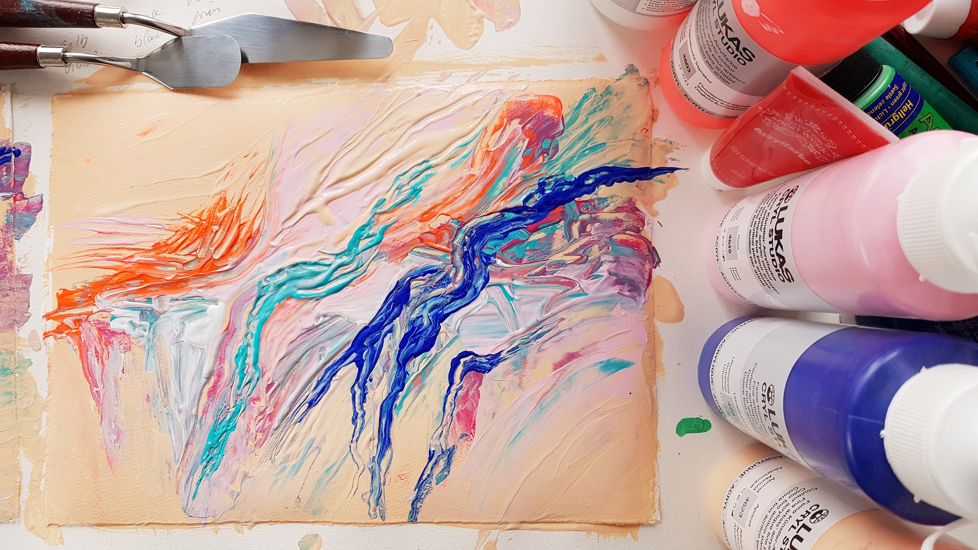
Two Useful Techniques
Product Discovery
Giving Impacts

Slide 14
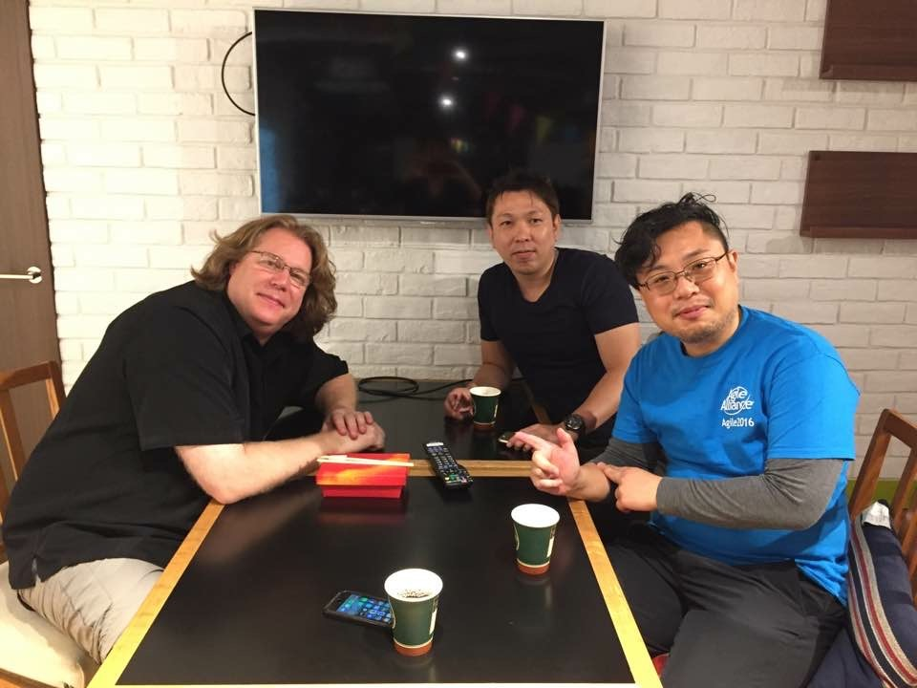
1. Product Discovery
Discovering/refining solutions
by iterative hypothesis and test cycle
by David Hussman
Persona
User Interview
User Story Mapping
MVP
KPI

Slide 15

Discover real concerns
and verbalize them
from
decision-makers
colleagues

Slide 16
Verbalized Concerns
Increase of outages in “Channel Gateway” service (CGW) was critical
Need failure detection mechanism for CGW
Testing APIs was insufficient in each service (Mainly did it manually then)

Slide 17

2. Giving Impacts
Do them constantly to attract
decision-makers/colleagues
“How Google Tests Software”
James A. Whittaker, Jason Arbon, and Jeff Carollo
Addison-Wesley Professional (2012)
ISBN-13: 9780132851558
Notes:
18:30

Slide 18



Impacts as SET
Hiro’s
Case
Deliver (executable) values weekly

Slide 19
Values Delivered (1)
Week 1 | Started writing test scripts to understand services
Week 2 | Proposed first idea of SET activities to decision-makers
Week 3 | Built mechanism to run and report static code analysis regularly
Week 4 | Shared to developers how to build static code analysis
Week 5 | Proposed milestones of activities to decision-makers

Slide 20
Values Delivered (2)
Week 6 | Agreed with proposals/milestones with decision-makers
Week 7 | Collected information and tools of Testers/QA in one place
Week 8 | Implemented failure detection for CGW
Week 9 | Guided to start regular meetings with developers and QA
Week10 | Started solving problems by developers step by step

Slide 21
Results
Within the first 3 months I joined :D
Many colleagues started
talking about SET
Decision-makers started
supporting SET activities positively
SET started
improvement activities for CGW

Slide 22
1. Importance of Getting Supports
2. Experience Hardships Together
3. Nurture All for Innovations
Notes:
22:00

Slide 23
Let’s Discuss! (5 min)
How to persuade
developers
to write test scripts?
Notes:
22:30 - 27:30

Slide 24

Key Point
Experiencing hardships
with
product development teams
together!

Slide 25
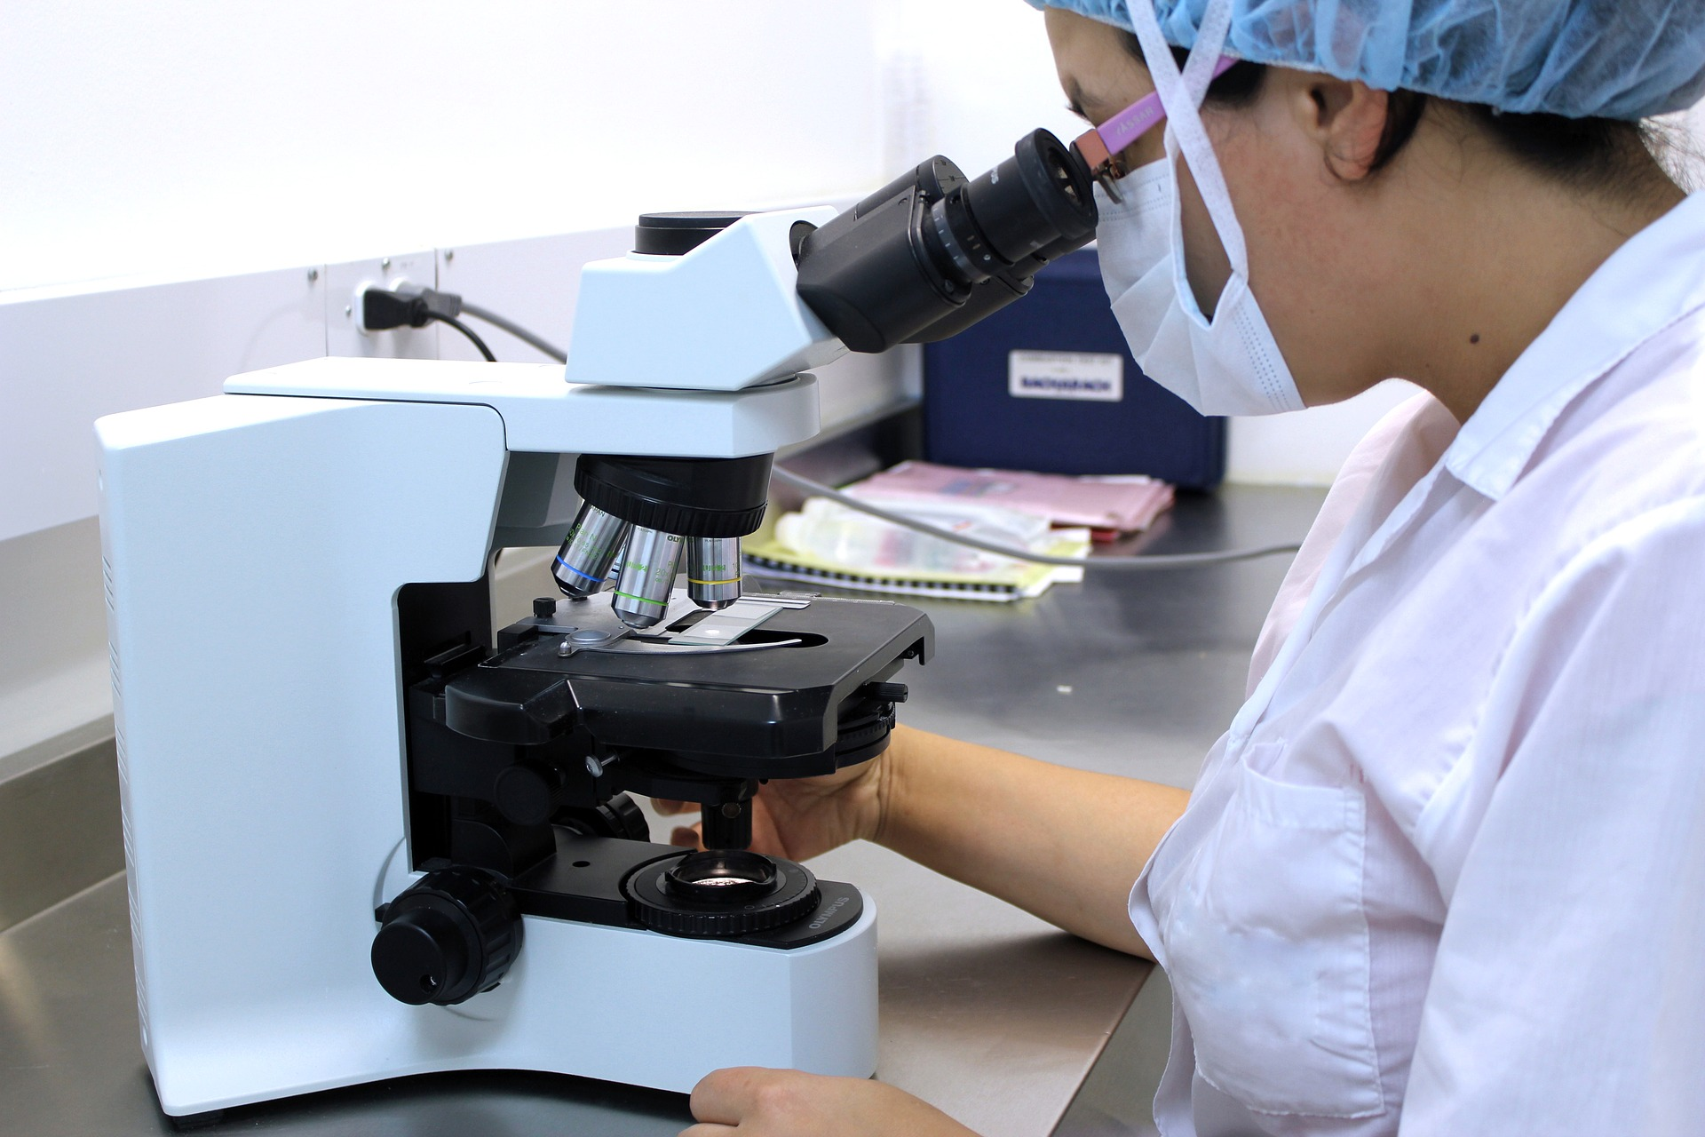
Our Experience Report
Failure detection system
at
CGW

Slide 26
System Image of CGW
Often caused outages
Tended to delay detecting failures
! This is an image !
Store
User
CGW
Game
Others

Slide 27
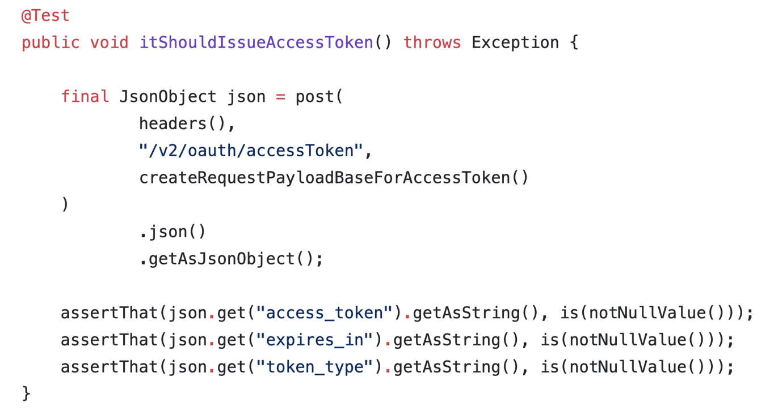
Ver.1 with JUnit and CI

Slide 28
Ver.1 with JUnit and CI
Didn’t
become established
at the team ☹
Test scripts are hard to read/implement/maintain
for developers/Product Manager

Slide 29
Product Discovery Again!

Slide 30
Karate as a Solution
Open-sourced framework
for testing APIs
Uses Gherkin syntax
Supports testing RESTful APIs
Easy to expand to test gRPC/Thrift
You can find it on Technology Radar

Slide 31
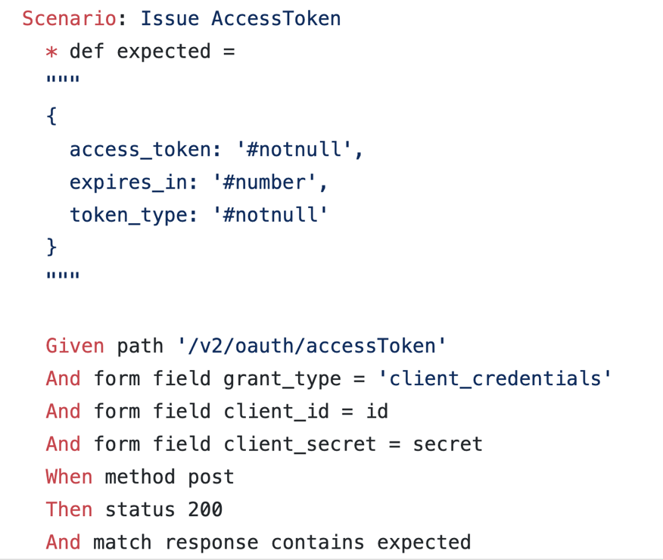
Ver.2 with Karate

Slide 32
Ver.1 with JUnit and CI

Slide 33

Experienced Hardships
With CGW members together
for 3 months
(CGW)
1) This case is hard to implement.
How to do it?
(SET)
2) OK. How about adding a Plugin like this?
(CGW)
3) Well, how about adding this feature, too?

Slide 34

Results
Became the model case of
improvements in our company!
Outages: - 30%
All members have been writing tests
Including Product Manager!

Slide 35
compassion (EN)
compatio (LA)

Slide 36
1. Importance of Getting Supports
2. Experience Hardships Together
3. Nurture All for Innovations
Notes:
40:00

Slide 37
Let’s Discuss! (5 min)
What is
the difficulty of
testing Microservices?
Notes:
40:00 - 45:00

Slide 38

Huge Blockers
Hiro’s
Case
Lack of skills of
Developers
Testers/QA
SET (us)

Slide 39

Key Point
Nurture
members/teams/orgs
for
our innovative activities

Slide 40
Learning Sessions in SET
Study sessions
during business hours :D
Taught by Chris Lucian,
the inventor of
Mob Programming,
at Agile2018

Slide 41
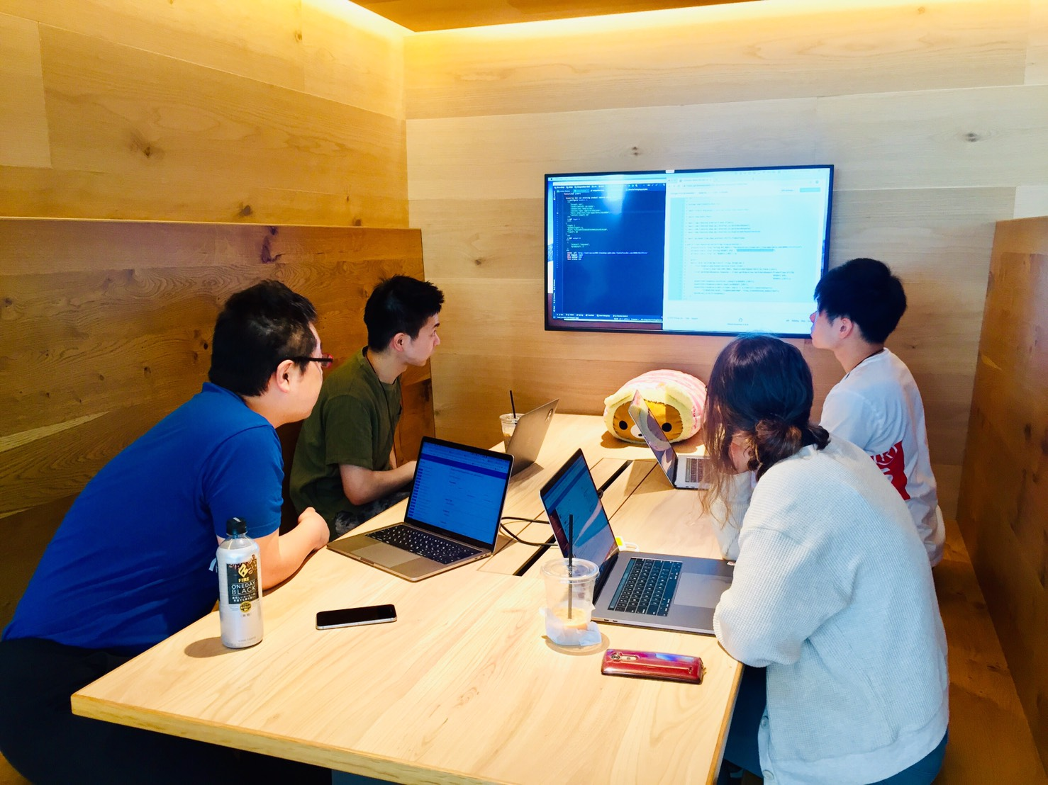
Our Team’s Rules
30 - 60 min/day everyday
During business hours as a work
Any topics OK for our daily work
With Mob Programming way
No criticism with a fun!

Slide 42
What We Learned
Kubernetes
Karate (API Testing)
Vue.js
Shortcut keys of IntelliJ IDEA
The Drucker Exercise
How to write a good report

Slide 43
Results
Invented “Sebas Report”
Can pinpoint the root cause of failures on Microservices
Can reduce MTTR (Mean Time To Recovery)
Can tame the complexity of Microservices

Slide 44
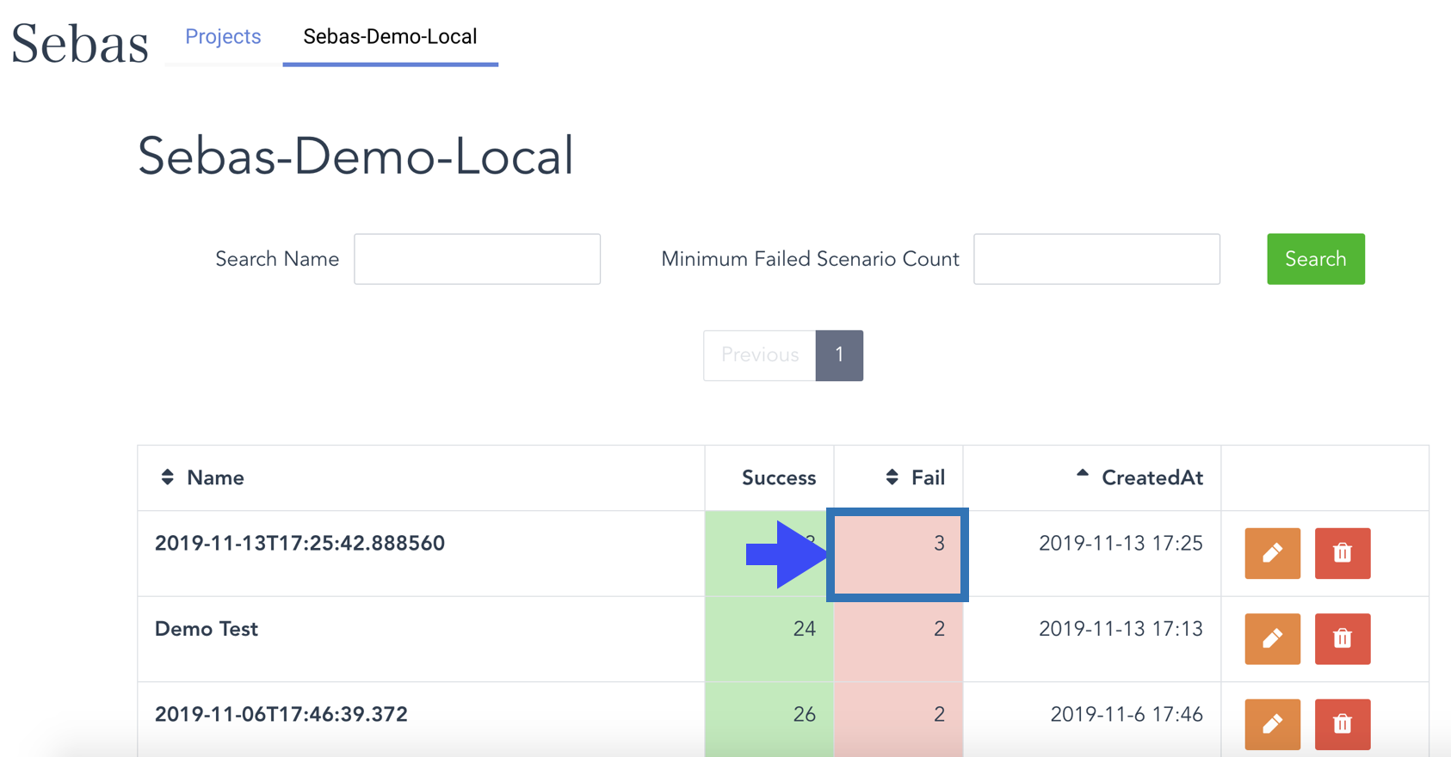
A Reporting Tool

Slide 45
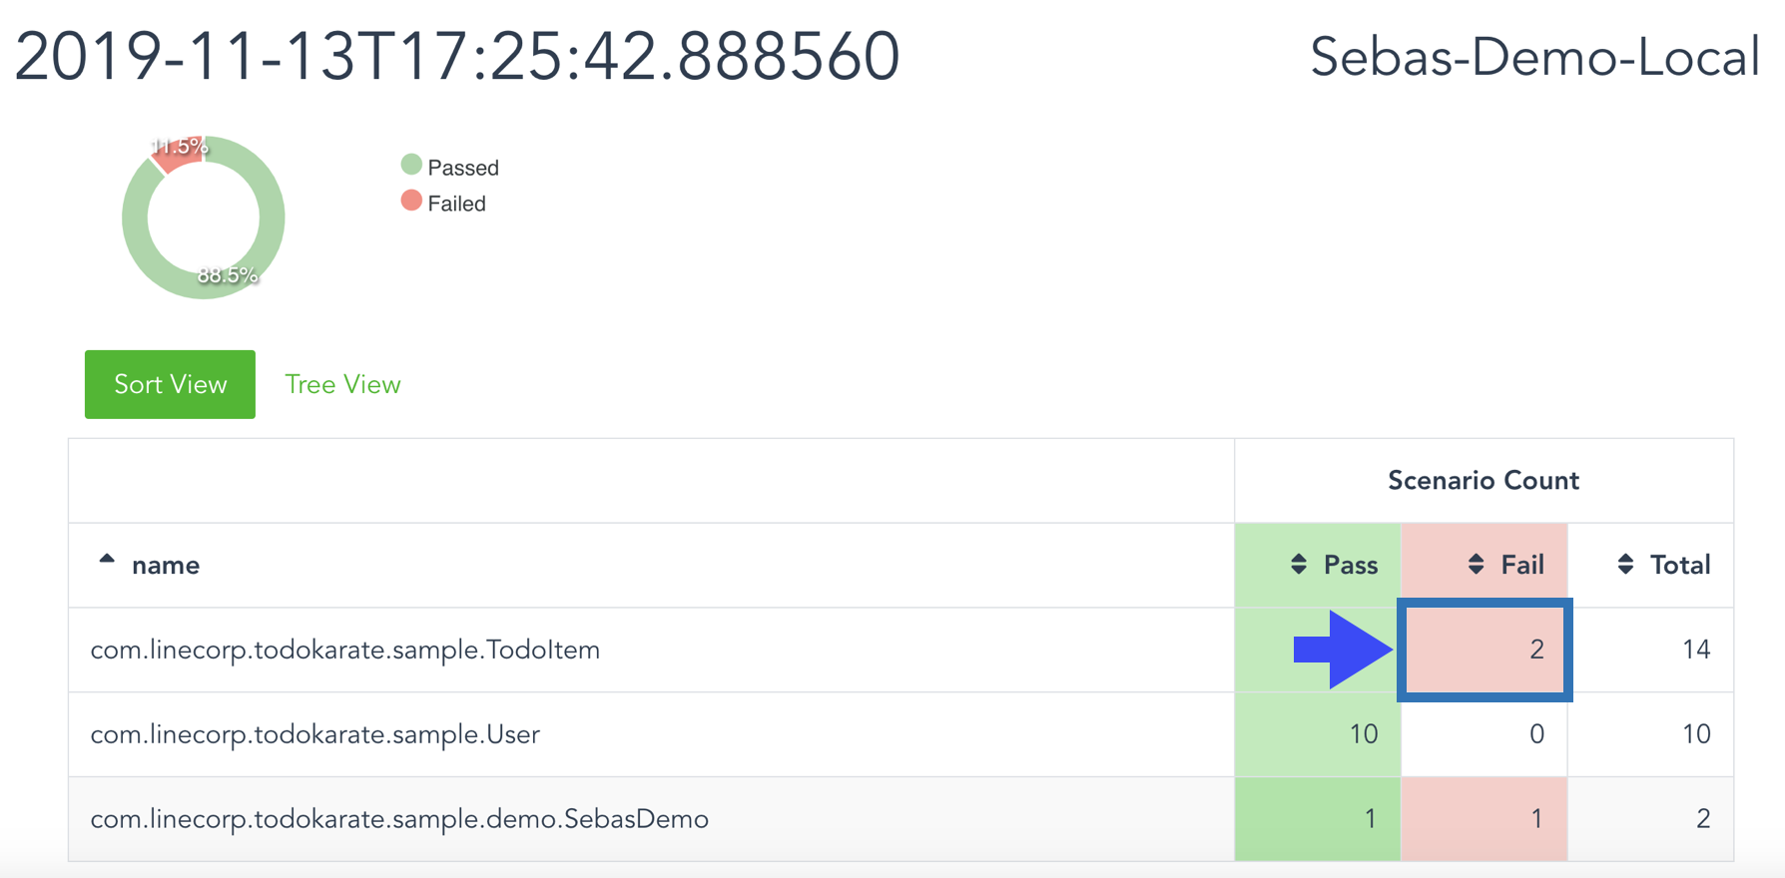
For Karate Users

Slide 46
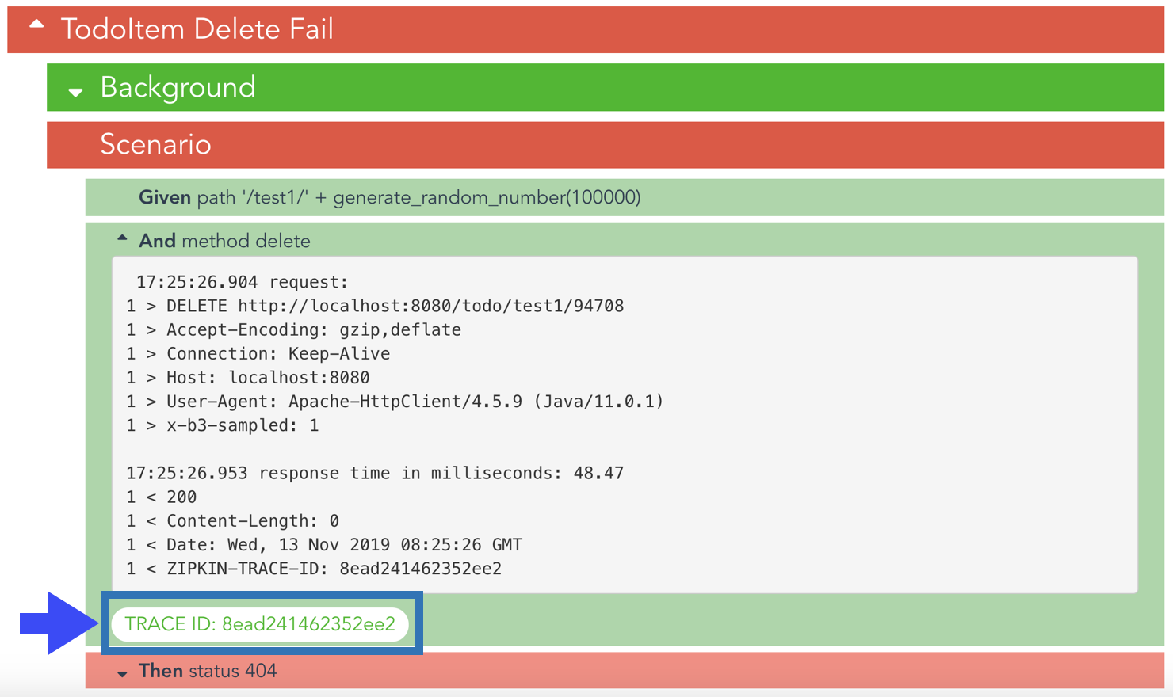
Pinpoint the Root Cause

Slide 47
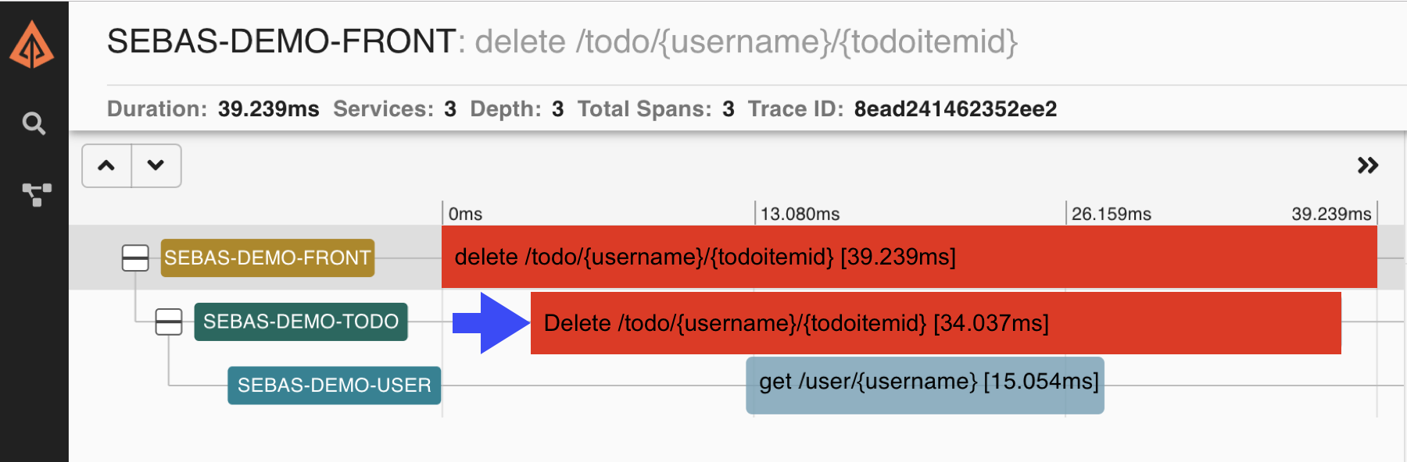
Visually And Very Quickly

Slide 48

By Using What We Learned

Slide 49

Results of Sebas Report
Improved MTTR
Failure detection: 1w -> 2hrs
Improved resilience
Can recover services quickly
Users are increasing
5 teams are using (2020/04)

Slide 50

[Appendix] Other Activities
Notes:
53:00

Slide 51

Ayaperf
In-house performance testing platform
This diagram includes the work
that is distributed in the Apache License 2.0.

Slide 52
Design Sprint
Do following tasks weekly
Clarify test-related issues
Choose one action
Build it quickly
Get feedback from “users”
Continue or pivot
“Sprint: How to Solve Big Problems
and Test New Ideas in Just Five Days”
Jake Knapp, John Zeratsky, and Braden Kowitz
Simon & Schuster (2016)
ISBN-13: 9781501121777

Slide 53


Testable Infrastructure
Trying to provide a platform
that can copy test environments
with Kubernetes
Notes:
Immutable Infrastructureのテスト版です。

Slide 54

Conclusion

Slide 55

Our Impacts
Some teams started actions
based on our activities!
One team contacted us and started using Sebas and Ayaperf
One team solved its slow test issues by their own

Slide 56

We can change difficulties into something special

Slide 57
...with proper approaches!

Slide 58
Our Examples
Getting Proper Supports
Experience Hardships Together
Nurture All for Innovations

Slide 59

Let’s experiment!

Slide 60

https://www.agilealliance.org/agile2021/
Notes:
59:00

